Slide 1
Game Sales and Data Visualization
8/10/2021
Andrew Wilson
Austen Hsiao

Slide 2



Introduction
Originally set out to investigate what makes a video game successful.
Data set issues lead to pivot to focus primarily on exploration of visualization tools and techniques.
Relationships to be visualized:
Average critic review scores by publisher
Total sales by genre and platform
Critic scores and total sales

Slide 3
Tableau

Slide 4
Tableau Public
Link: https://public.tableau.com/app/profile/andrew.wilson7224/viz/GameSalesVisualizations/GameSalesVisualizations

Slide 5
Python

Slide 6
Python Tools
Matplotlib
Seaborn
Pandas

Slide 7
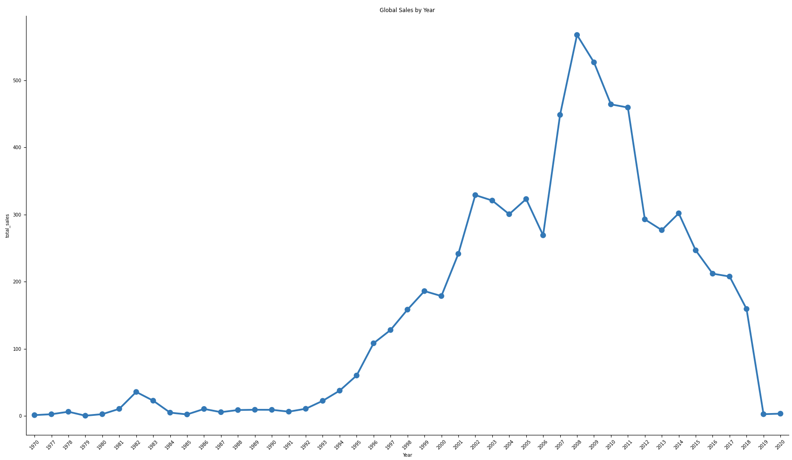
Python Recreations: Global Sales

Slide 8
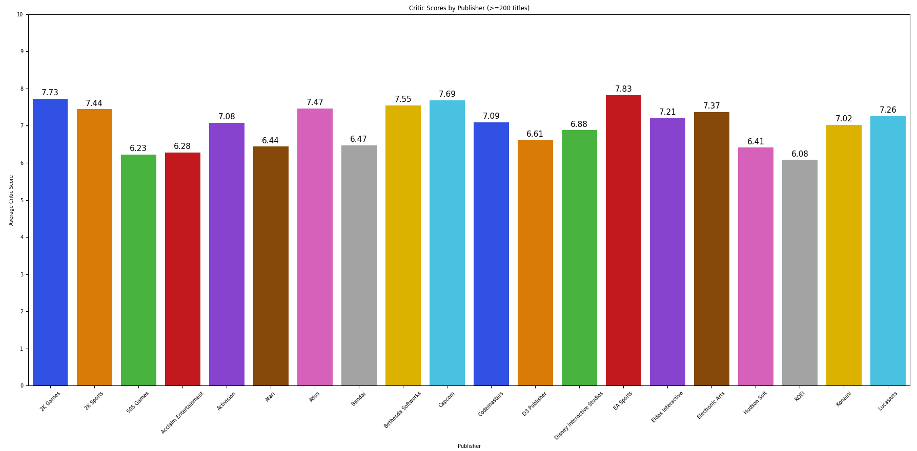
Python Recreations: Review Scores by Publishers

Slide 9
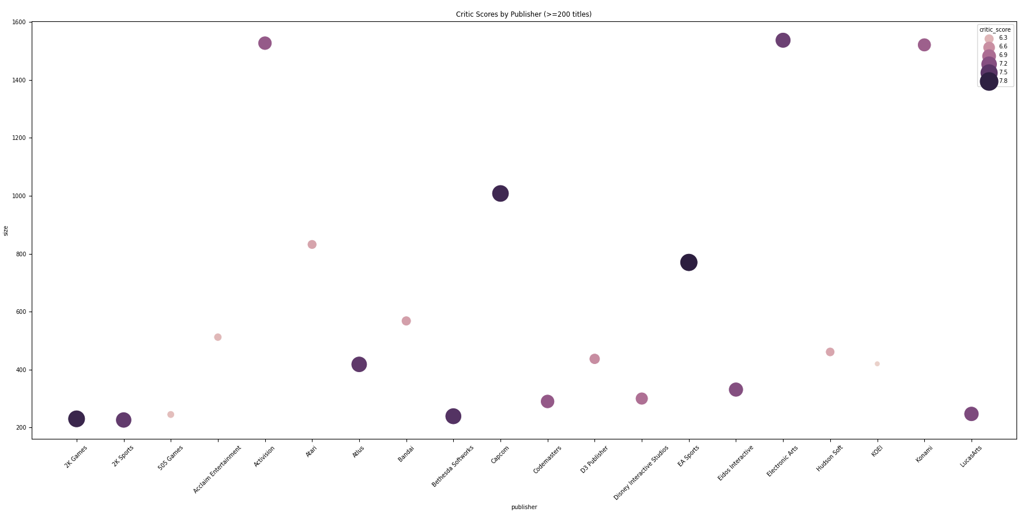
Python Recreations: Review Scores by Publishers

Slide 10
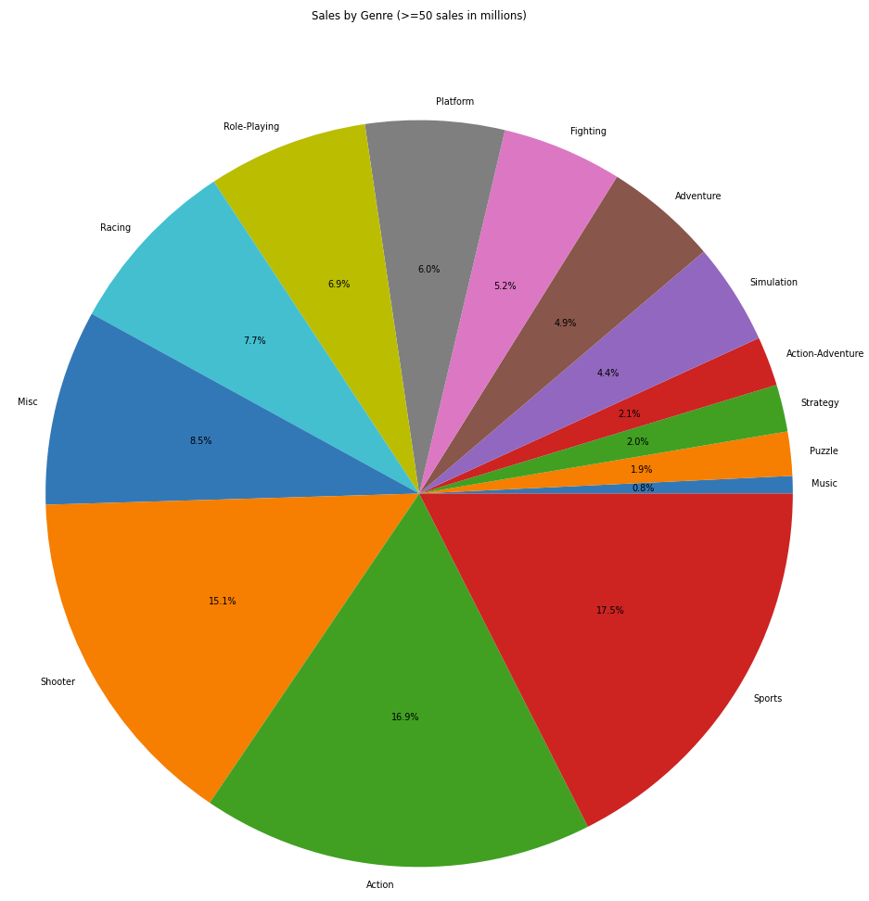
Python Recreations: Sales by Genre

Slide 11
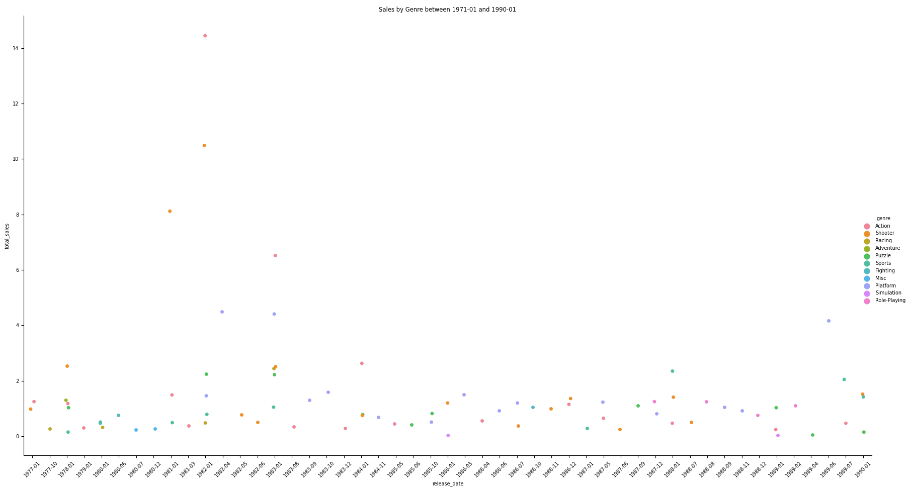
Python Recreations: Sales by Genre

Slide 12
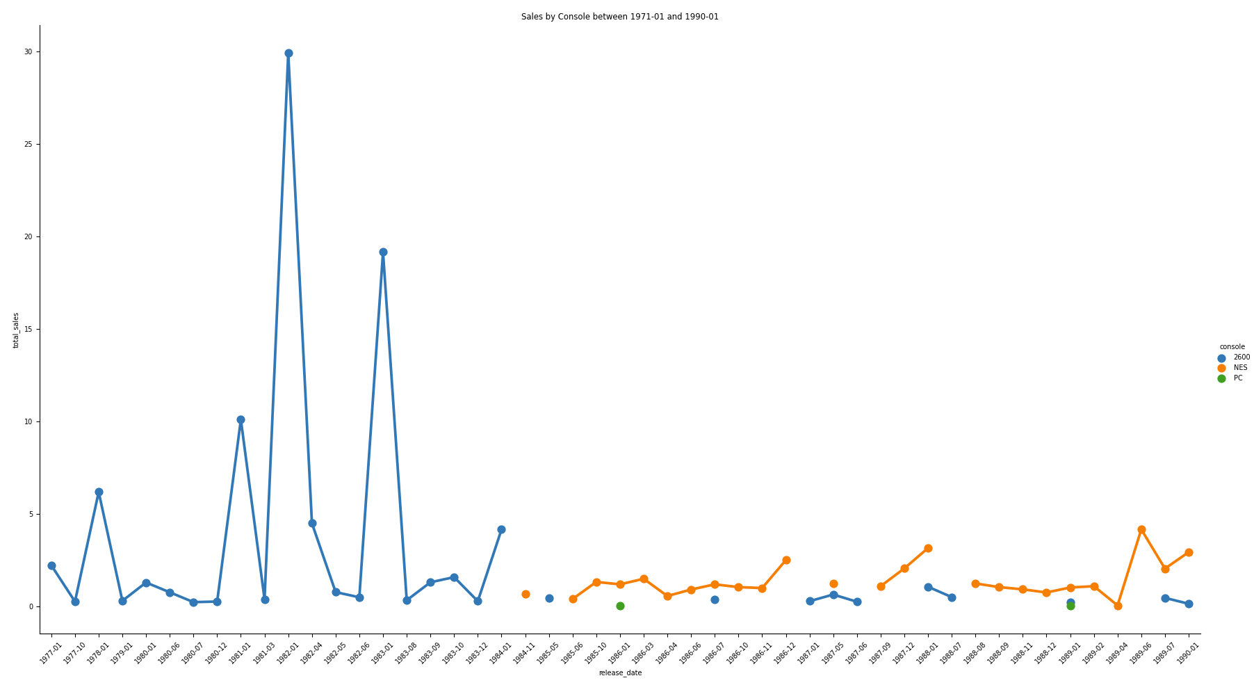
Python Recreations: Sales by Platform

Slide 13
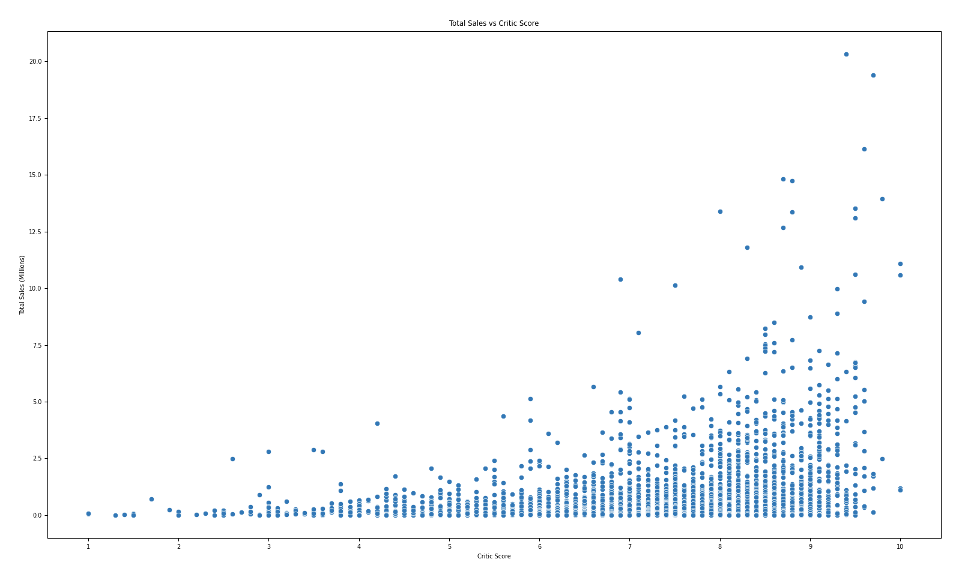
Python Recreations: Total Sales vs Critic Scores

Slide 14
In Summary...
Python
Pros
Free
Easy for simple visualizations
Cons
Formatting
Unique graphs
Run time
Tableau
Pros
It is intuitive
Easy to duplicate/slice/remix data views
Tableau public makes sharing a snap
Good as either ‘first step’ to do rough vizs or as main tool for full analysis
Cons
Limited access ‘under the hood’
Cost $$$

Slide 15
“Dedicated business intelligence software exists for a reason! Try using something besides Excel next time you want to look at data!”
Andy & Austen, 2021

Slide 16
Questions?

Slide 17

License
The materials for this presentation and project are licensed under CC BY-NC-SA (Attribution-NonCommercial-ShareAlike)
Creative Commons — Attribution-NonCommercial-ShareAlike 4.0 International — CC BY-NC-SA 4.0
Contact: anwils2@pdx.edu or ahsiao@pdx.edu

Slide 18
GitHub Link
https://github.com/AustenHsiao/data_science_sales

Slide 19
Sources
(1) Brannen, B. Video Game Sales 2020. (July 2020). Retrieved July 10th, 2021 from https://www.kaggle.com/baynebrannen/video-game-sales-2020
(2) Mordor Intelligence. Gaming Market - Growth, Trends, COVID-19 Impact, and Forecasts (2021 - 2026); 2021.
(3) Babb, J.; Terry, N. Comparing Video Game Sales by Gaming Platform. Southwest. Econ. Rev. 2013, 40 (1), 25–46.
(4) Cox, J. What Makes a Blockbuster Video Game? An Empirical Analysis of US Sales Data. Manag. Decis. Econ. 2014, 35 (3), 189–198. https://doi.org/10.1002/mde.2608.
(5) Pratt, M; Fruhlinger J. 2019. What is business intelligence? Turning data into business insights. (October 2019). Retrieved July 5, 2021 from https://www.cio.com/article/2439504/business-intelligence-definition-and-solutions.html
(6) Tanner, G. 2019. Introduction to Data Visualization in Python. Retrieved July 7, 2021, from https://towardsdatascience.com/introduction-to-data-visualization-in-python-89a54c97fbed

